Slide 1


Abby Wang
2023.6.17

Slide 2
Outline
Executive Summary
Introduction
Methodology
Results
Conclusion
Appendix

Slide 3
Executive Summary
Summary of methodologies
Data collection
Data wrangling
EDA with data visualization
EDA with SQL
Building an interactive map with Folium
Building a Dashboard with Plotly Dash
Predictive analysis (Classification)
Summary of all results
Exploratory data analysis results
Interactive analytics demo in screenshots
Predictive analysis results

Slide 4

Introduction
The commercial space age has arrived, with companies like Virgin Galactic, Rocket Lab, Blue Origin, and SpaceX making space travel affordable and accessible. SpaceX stands out with its achievements in sending spacecraft to the International Space Station, launching a satellite internet constellation, and sending manned missions to space. One of the reasons SpaceX can do this is because its rocket launches are relatively inexpensive. If it can determine if the first stage of its Falcon 9 rocket will land successfully, it can determine the cost of a launch. In this capstone project, the goal is to determine the price of each launch for a new rocket company, Space Y, founded by billionaire industrialist Allon Musk, by gathering information about SpaceX and creating dashboards for the team. The project also involves training a machine learning model to predict if SpaceX will reuse the first stage.
The main issues we need to address in this project include determining the cost of each launch for Space Y by gathering information about SpaceX and creating dashboards for the team. We also need to train a machine learning model to predict if SpaceX will reuse the first stage. Additionally, we need to determine if the first stage of SpaceX's Falcon 9 rocket will land successfully, which will help us determine the cost of a launch.
To accomplish these goals, we will need to gather data about SpaceX's Falcon 9 rocket and analyze it to understand the factors that affect the cost of a launch. We will also need to collect data on the success rate of first stage landings and use this information to train our machine learning model. Finally, we will need to create dashboards to help us visualize and analyze the data we collect and use it to make informed decisions about the cost of each launch.
This project will require a multidisciplinary approach, combining skills in data analysis, machine learning, and dashboard creation. By successfully completing this project, we will be able to provide valuable insights to Space Y and help them compete with SpaceX in the commercial space industry.

Slide 5

Section 1

Slide 6
Methodology
Executive Summary
Data collection methodology:
Use an API and web scraping (Json_normalize, BeautifulSoap)
Perform data wrangling
Convert outcomes into training labels
Perform exploratory data analysis (EDA) using visualization and SQL
Perform interactive visual analytics using Folium and Plotly Dash
Perform predictive analysis using classification models
How to build, tune, evaluate classification models

Slide 7

Data Collection
Two methods of collecting data discussed in this report are using an API and web scraping. The SpaceX REST API provides launch data including information about the rocket used, payload delivered, launch specifications, landing specifications, and landing outcome. To convert the JSON response from the API into a dataframe, the json_normalize function is used. Web scraping related Wiki pages can also provide Falcon 9 launch data. Python's BeautifulSoup package can be used to scrape HTML tables that contain valuable launch records, which can then be parsed and converted into a Pandas dataframe for further analysis.

Slide 8
Data Collection – SpaceX API
GitHub URL of the completed SpaceX API calls notebook:
https://github.com/Abby-tingzhi-wang/SpacesX-Falcon-9/blob/main/jupyter-labs-spacex-data-collection-api%20(4).ipynb
Send request
Endpoint: https://api.spacexdata.com/v4/launches/past
Status code 200
.json_normalize()
Normalize data

Slide 9
Data Collection - Scraping
GitHub URL of the completed web scraping notebook:
https://github.com/Abby-tingzhi-wang/SpacesX-Falcon-9/blob/main/jupyter-labs-webscraping%20(2).ipynb
soup
BeautifulSoup
Data frame
HTML table
Save dataset_part_1_csv file

Slide 10

Data Wrangling
True Ocean means the mission outcome was successfully landed to a specific region of the ocean while False Ocean means the mission outcome was unsuccessfully landed to a specific region of the ocean. True RTLS means the mission outcome was successfully landed to a ground pad False RTLS means the mission outcome was unsuccessfully landed to a ground pad. True ASDS means the mission outcome was successfully landed on a drone ship False ASDS means the mission outcome was unsuccessfully landed on a drone ship.
We will mainly convert those outcomes into Training Labels with 1 means the booster successfully landed 0 means it was unsuccessful.
The mean successful rate is 0.6666666666
GitHub URL: https://github.com/Abby-tingzhi-wang/SpacesX-Falcon-9/blob/main/IBM-DS0321EN-SkillsNetwork_labs_module_1_L3_labs-jupyter-spacex-data_wrangling_jupyterlite.jupyterlite.ipynb

Slide 11
EDA with Data Visualization
Scatter plot chart are used to analyze the impact of ‘Launch site’ and ‘Pay load mass’ to the successful rate of launching.
GitHub URL:
SpacesX-Falcon-9/eda-sql-coursera.ipynb at main · Abby-tingzhi-wang/SpacesX-Falcon-9 (github.com)

Slide 12
EDA with SQL
SQL queries:
.unique()
.str.startswith('CCA’)], .str.contains(‘F9 v1.0’)
.sum(), .mean(), .min()
GitHub URL of your completed EDA with SQL notebook:
SpacesX-Falcon-9/eda-sql-coursera.ipynb at main · Abby-tingzhi-wang/SpacesX-Falcon-9 (github.com)

Slide 13
Build an Interactive Map with Folium
We created the map subjects such as marker, circle, distance on the folium map to identify the launch location.
GitHub URL: SpacesX-Falcon-9/launch_site_location.jupyterlite.ipynb at main · Abby-tingzhi-wang/SpacesX-Falcon-9 (github.com)

Slide 14

Build a Dashboard with Plotly Dash
The dashboard includes two interactive charts, one is bar charts showing total successful launches by all sites. It clearly shows the percentages of success rate of each sites. The second chart is the scatter chart of Payload mass (kg) and class (0 failure, 1 success). It indicates the relationship between Payload and successful launch rate.
Github URL: https://github.com/Abby-tingzhi-wang/SpacesX-Falcon-9/blob/main/spacex_dash_app%20(1).py

Slide 15

BUILDING MODEL
Load our dataset into NumPy and Pandas
Transform Data
Split our data into training and test data sets
Check how many test samples we have
Decide which type of machine learning algorithms we want to use
Set our parameters and algorithms to GridSearchCV
Fit our datasets into the GridSearchCV objects and train our dataset.
EVALUATING MODEL
Check accuracy for each model
Get tuned hyperparameters for each type of algorithms
Plot Confusion Matrix
IMPROVING MODEL
Feature Engineering
Algorithm Tuning
FINDING THE BEST PERFORMING CLASSIFICATION MODEL
The model with the best accuracy score wins the best performing model
In the notebook there is a dictionary of algorithms with scores at the bottom of the notebook.
Predictive Analysis (Classification)
Github URL: https://github.com/Abby-tingzhi-wang/SpacesX-Falcon-9/blob/main/SpaceX_Machine_Learning_Prediction.jupyterlite.ipynb

Slide 16
Exploratory data analysis results
Interactive analytics demo in screenshots
Predictive analysis results
Results

Slide 17

Section 2

Slide 18
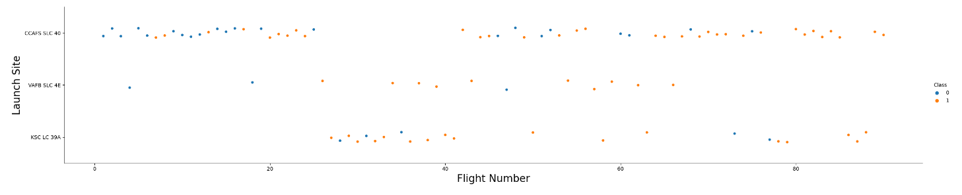
Flight Number vs. Launch Site
Flight number over 80 is always launched successfully;
VAFB SLC 4E is most successful among flight number 20-60;

Slide 19
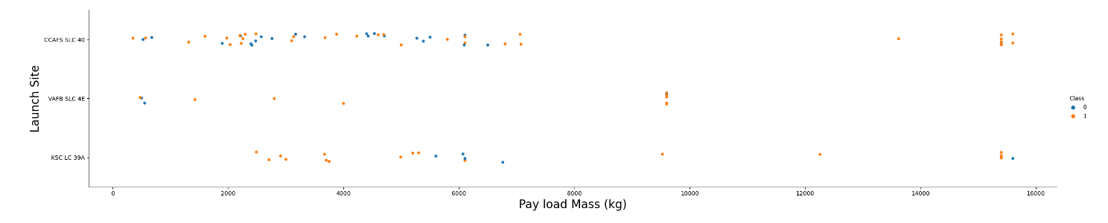
Payload vs. Launch Site
VAFB-SLC launchsite there are no rockets launched for heavy payload mass(greater than 10000);
CCAFS SLC 40 is more likely to succeed when Pay load mass over 7000 kg;
KSC LC 39A is more likely to succeed when Pay load mass less than 5000 kg

Slide 20
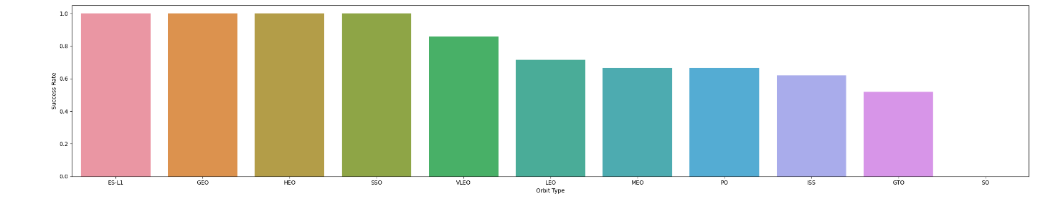
Success Rate vs. Orbit Type
ES-L1, GEO, HEO and SSO have high success rate

Slide 21
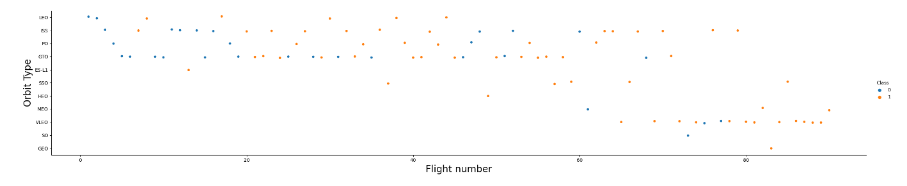
Flight Number vs. Orbit Type
The orbit HEO, MEO, VLEO, SO, GEO used when flight number over 60;
The orbit ISS has the most successful rate with flight number among 20-40 and over 60;
The orbit VLEO launched successfully with flight number over 80

Slide 22
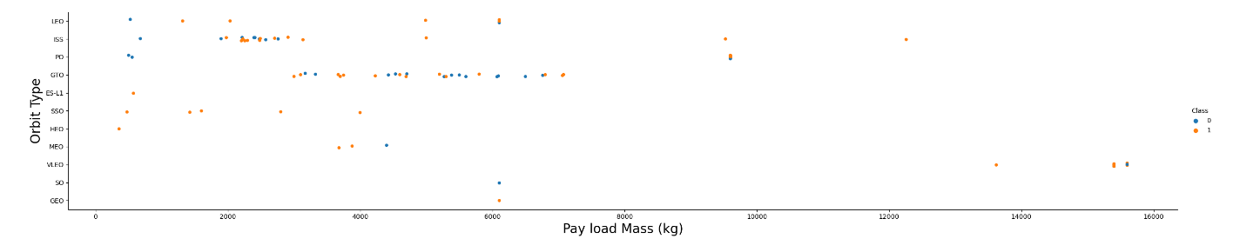
Payload vs. Orbit Type
With heavy payloads the successful landing or positive landing rate are more for Polar, LEO and ISS.
However for GTO we cannot distinguish this well as both positive landing rate and negative landing(unsuccessful mission) are both there here.

Slide 23
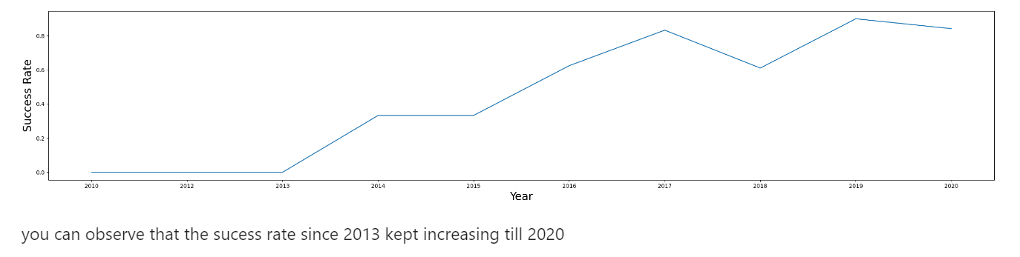
Launch Success Yearly Trend

Slide 24
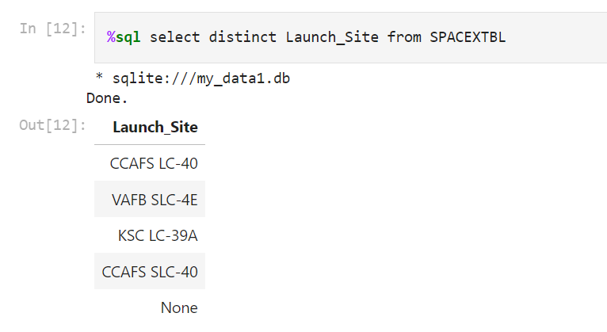
All Launch Site Names

Slide 25
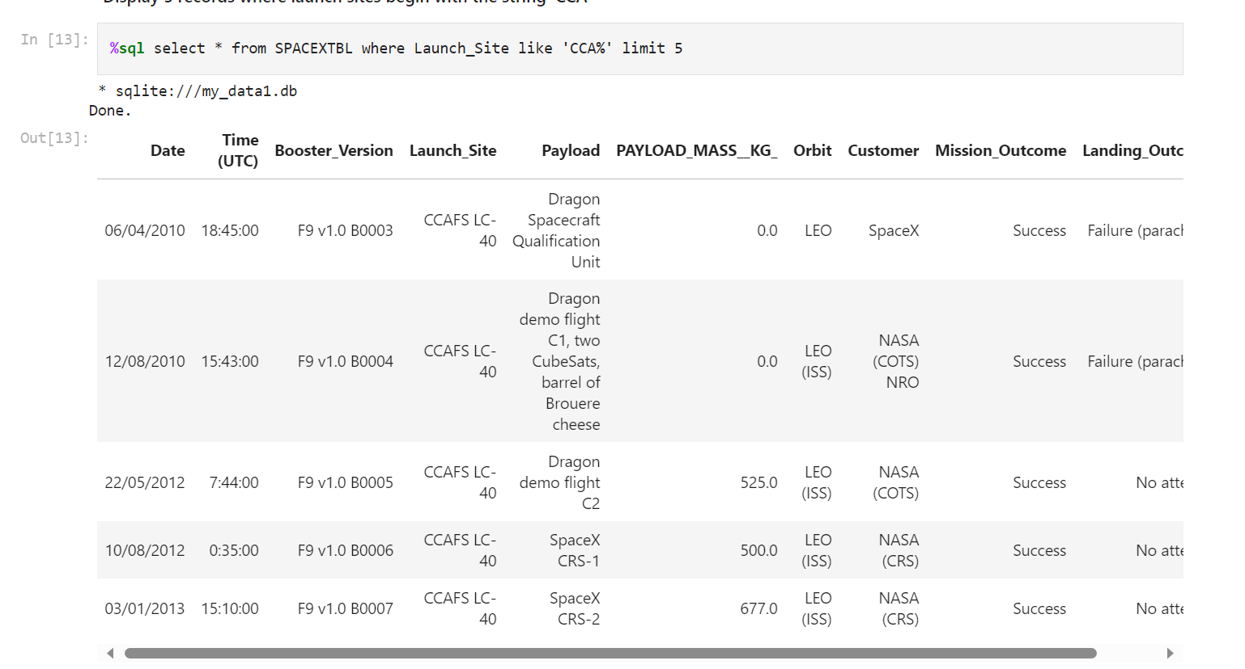
Launch Site Names Begin with 'CCA'

Slide 26
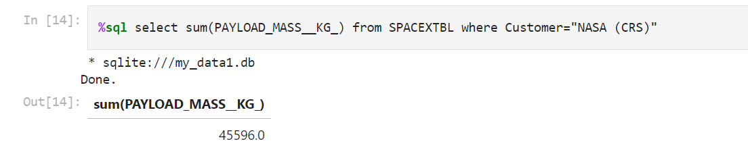
Total Payload Mass

Slide 27
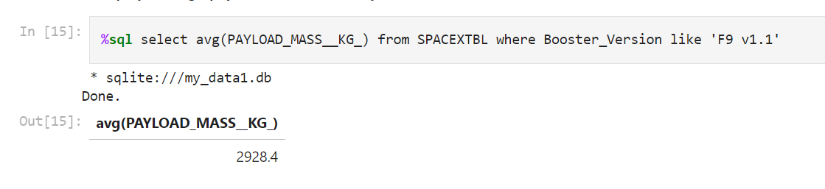
Average Payload Mass by F9 v1.1

Slide 28
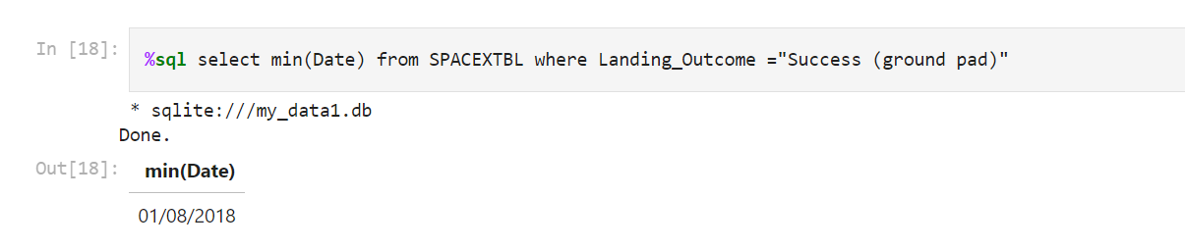
First Successful Ground Landing Date

Slide 29
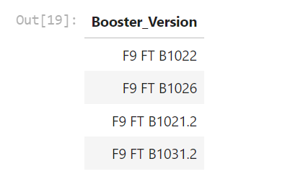
Successful Drone Ship Landing with Payload between 4000 and 6000
%sql select distinct Booster_Version from SPACEXTBL where Landing_Outcome="Success (drone ship)" and PAYLOAD_MASS__KG_ between 4000 and 6000

Slide 30
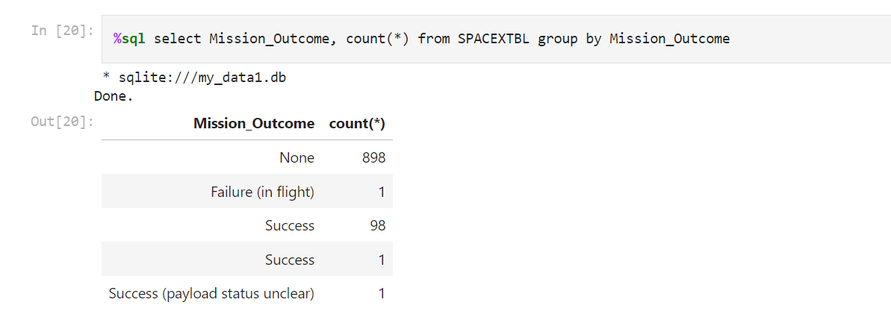
Total Number of Successful and Failure Mission Outcomes

Slide 31
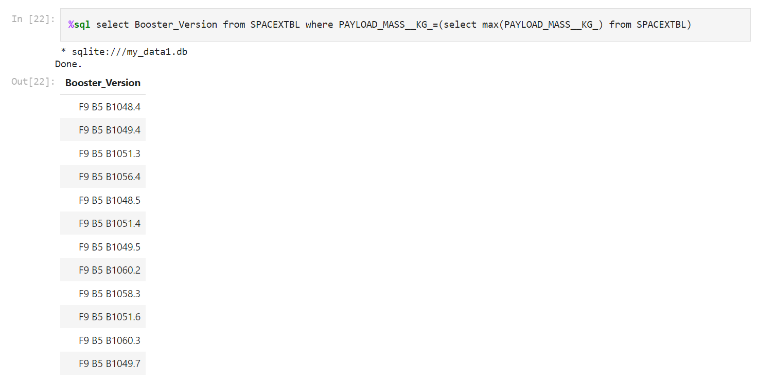
Boosters Carried Maximum Payload

Slide 32
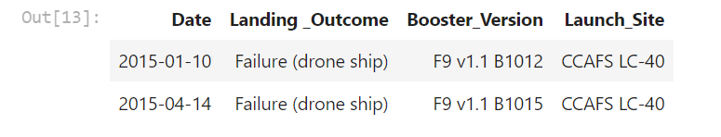
2015 Launch Records
%sql SELECT substr(Date, 4, 2) as Month , Landing_Outcome, Booster_Version, Launch_Site FROM SPACEXTBL WHERE substr(Date, 4, 2) = "2015" AND Landing_Outcome= "Failure (drone ship)"

Slide 33
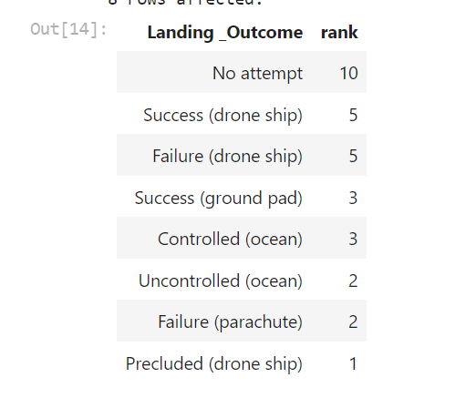
Rank Landing Outcomes Between 2010-06-04 and 2017-03-20
%sql select Landing_Outcome,count(*) as rank from SPACEXTBL where Date between '2010-06-04' and '2017-03-20' and Landing_Outcome like 'Success' group by Landing_Outcome order by rank desc

Slide 34

Section 3

Slide 35
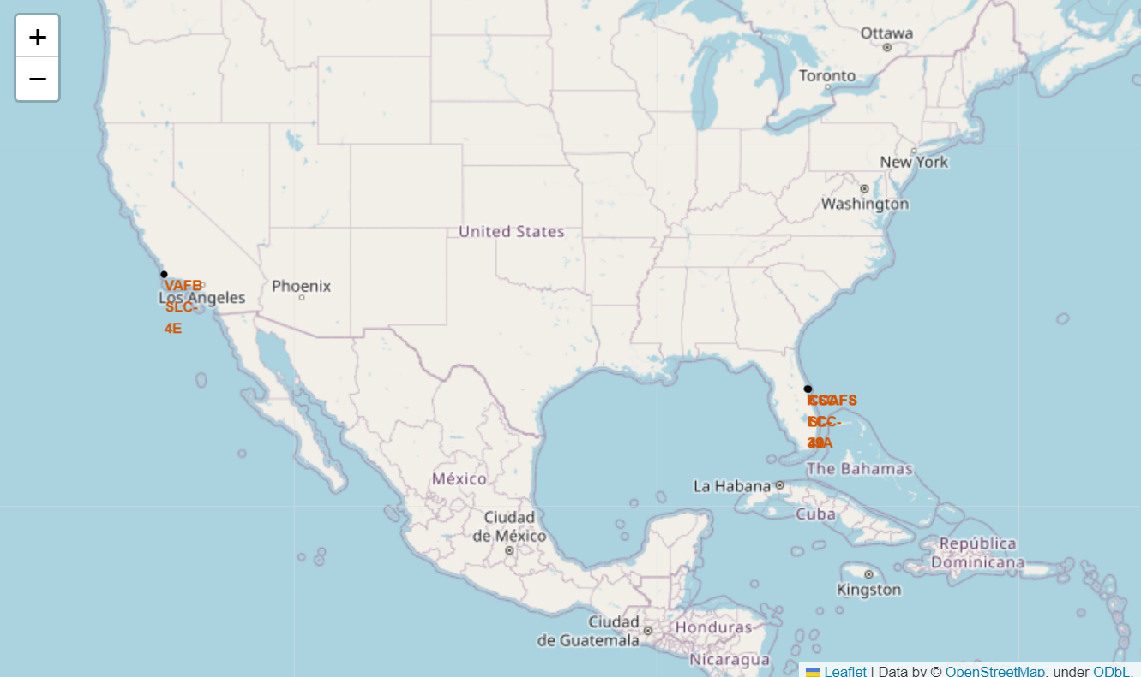
Global launch sites

Slide 36
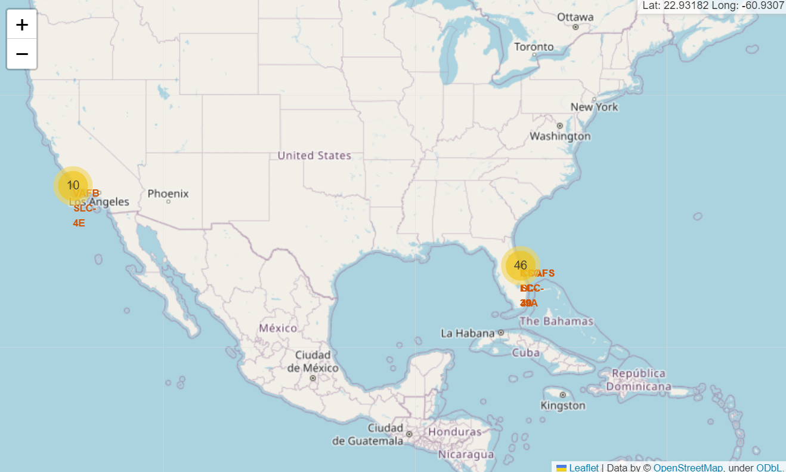
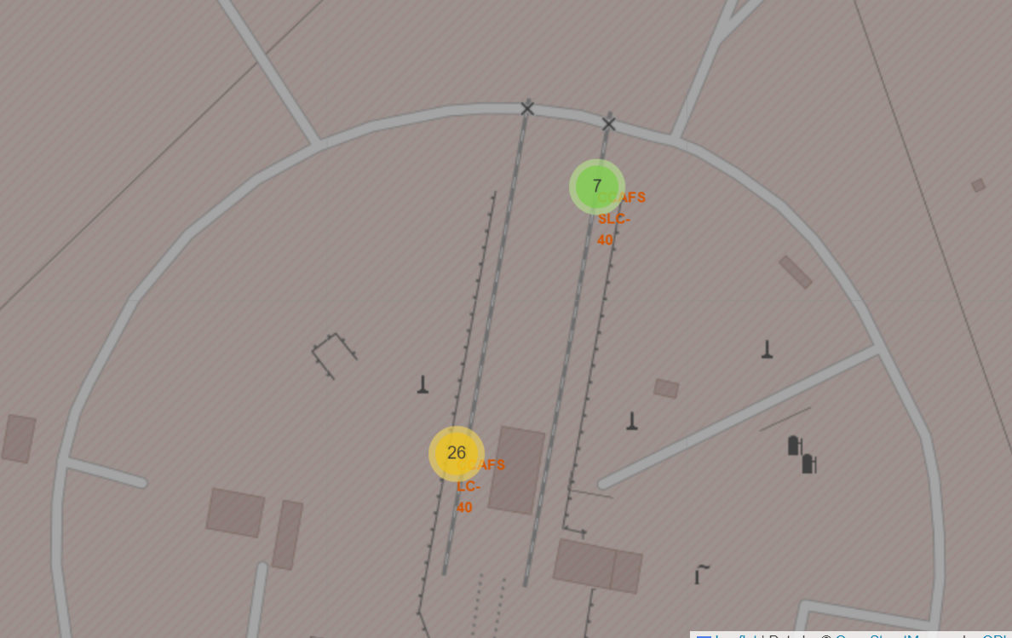
Mark the success/failed launches for each site on the map

Slide 37
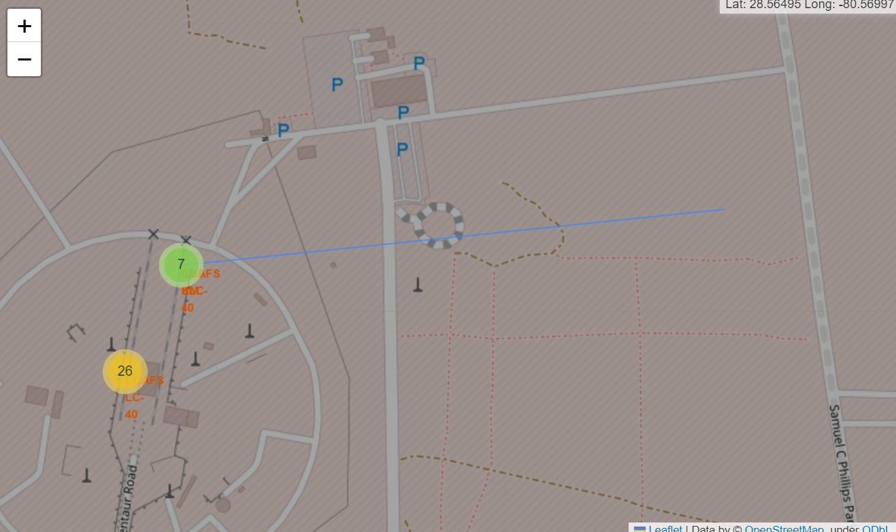
the distances between a launch site to its proximities

Slide 38

Section 4

Slide 39
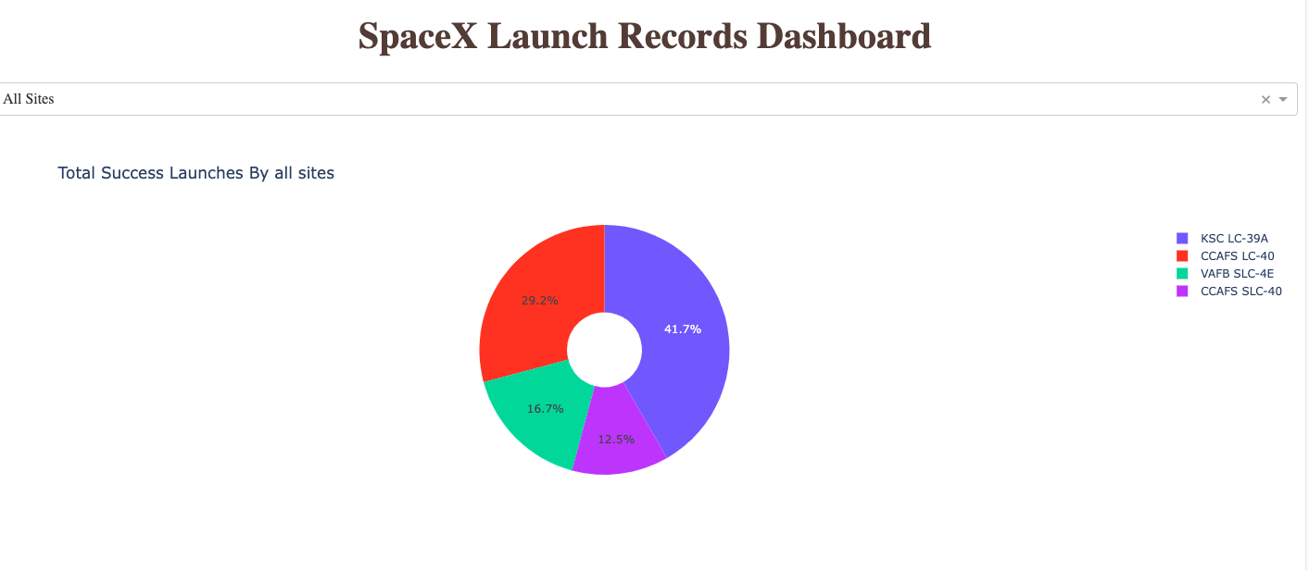
Total Successful launch by all sites
The launch site KSC- LC 39A has the highest success rate; While CCAFS-SLC 40 has the lowest success rate

Slide 40
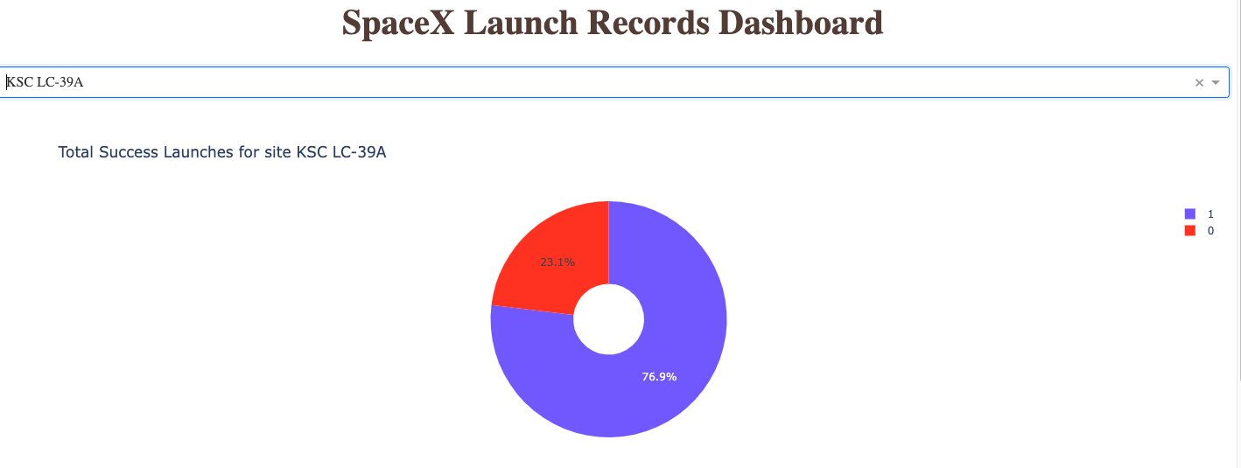
Total successful launches for site KSC LC-39A
In the launch site KSC-LC 39A, successful launch rate is 76.9%, failure rate is 23.1%

Slide 41
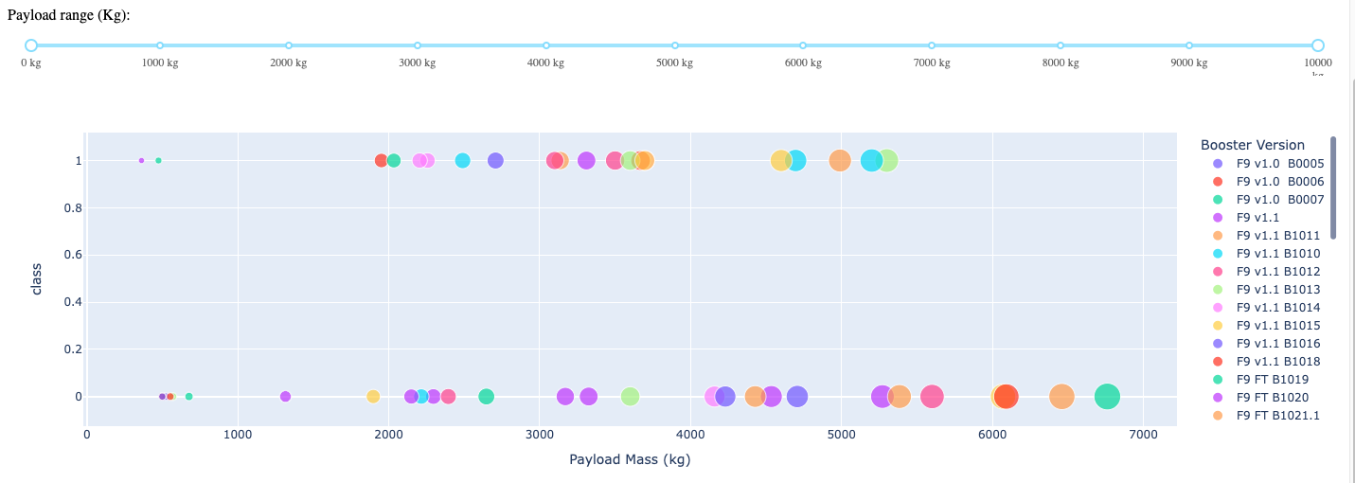
The Relationship between Payload and Successful rate
When payload is over 5600 kg, it’s hard to success, all launches are failure. When payload among 4700-5270 kg, all launches are successful. Payload among 3800- 4500 kg, it’s easier to failure.

Slide 42

Section 5

Slide 43
Classification Accuracy

Slide 44
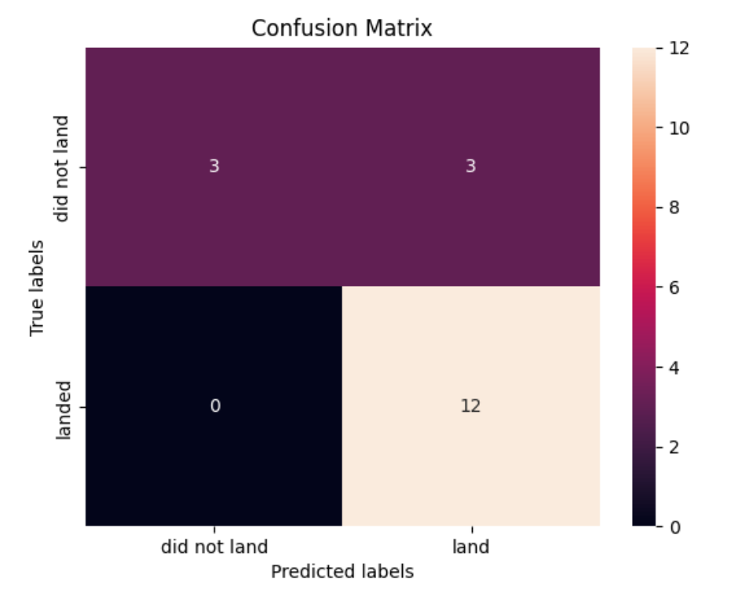
Confusion Matrix
confusion matrix is the heatmap showing prediction results. From the chart we can see that True labels use Y_test data, X_test is used for predicted results. We can see that number of truly landed is 12, truly did not landed is 3, predicted landed but truly not landed is 3, predicted not landed but landed is 0.

Slide 45
The Tree Classifier Algorithm is the best for Machine Learning for this dataset
Low weighted payloads perform better than the heavier payloads
The success rates for SpaceX launches is directly proportional time in years they will eventually perfect the launches
We can see that KSC LC-39A had the most successful launches from all the sites
Orbit GEO,HEO,SSO,ES-L1 has the best Success Rate
Conclusions

Slide 46
Appendix
Include any relevant assets like Python code snippets, SQL queries, charts, Notebook outputs, or data sets that you may have created during this project

Slide 47


